Slide 1

SEMESTER I 2020/2021
FSKTM, UTHM
Thursday, 17th June 2021
2nd Industrial Training Briefing

Slide 2
Agenda
Industrial Training Guidelines
Industrial Training Process
Assessment and Important Documents
Discipline, attendance and work leave
Issues and problems
Notes:
2

Slide 3
Important Dates
Duration: 24 weeks –16th August 2021 – 28th January 2022
IMPORTANT DATES | ITEM | NOTES
16 – 20 Aug 2021 | Update Placement | Please update placement information after you report to company especially supervisor name, company address.
16 – 24 Aug 2021 | Request Change of Placement | Any request change of placement / company MUST be done within time frame. Any request after that will not be entertained.
13 – 24 Sept 2021 | First Supervision Phase | Submit Preliminary Industrial Training Report Submit letter from company if you are allowed to work from home
26 Dec 2021 – 7 Jan 2022 | Second Supervision Phase | Submit Final Industrial Training Report Submit Logbook Draft Prepare for presentation Remind Industry Supervisor to submit marks
30 Jan – 4 Feb 2022 | Logbook Submission | Submit a complete logbook to Author
Notes:
3

Slide 4
Industrial Training Guidelines
Have you read
Panduan Latihan Industri UTHM?
Please download from eLI System

Slide 5
Industrial Training Online Registration
via e-LI
New e-LI functions student can-
print their of cover letter
Print LI confirmation letter
Print rejection letter
Application to register new companies
E-LogBook

Slide 6
Industrial Training Application Process
START
Y
Confirmed your placement with PKKA (mail offer to li@uthm.edu.my)
Any offer? (3 wks)
Register Internship Semester in eLI system
Request Add New Company to li@uthm.edu.my
N
Send to the company (email/post)
Coordinator verify the registration application
Update internship in eLI (Start internship)
Download cover letter and CV
Update CV in eLI
Check LI subject in SMAP (automatic registered from eLI)
Y
Choose the company (max 3 companies)
END
Is the company listed?
Add new company by clicking “syarikat tiada dalam senarai”
N
Wait for Coordinator Approval (1-2 working day)

Slide 7
Application Procedures
Via PKKA:e-LI (Industrial Training Registration Online)
Choose maximum 1-3 companies at a time.
If rejected, then apply again.
This method is preferable since most companies prefer to receive formal letter from the University
**Coordinator have the right to reject student’s choice of company if it does not comply to condition set out by the committee.

Slide 8
Industrial Training Process After Placement
START
Student may contact the faculty supervisor to discuss the project or task assigned
Second Supervising Phase -Evaluation will commence Submit Final Report , Draft Logbook and Industrial Supervisor Evaluation Form (26 Dec 2021- 7 Jan 2022)
Student Report (Lapor Diri) to Company
First Supervising Phase-Submit Preliminary Industrial Training Report to Faculty Supervisor and Author (13 – 24 Sept 2021)
Update Reporting Data (lapor dri) in eLI within 1 week
Submit Complete Logbook (30 Jan – 4 Feb 2022)
Coordinator received the latest list of student placement
Student fill in Personal Information in Evaluation Forms (Borang Markah) for Faculty and Industrial Supervisor
Result (HL/HG)
Coordinator will assign students to prospective faculty supervisor
Faculty Supervisor will arrange for evaluation that will be held on 26 Dec 2021 – 7 Jan 2022
END
Coordinator will release the supervisor list in Telegram Group and FB

Slide 9
First Supervising Phase Activities
Date 13th – 24th Sept 2021 – Submission of Preliminary Industrial Training Report
Faculty supervisor will discuss student activities and problem with industry supervisor. Make sure the industrial supervisor can be contacted (give email and phone numbers).
Student are is encouraged to send logbook draft to faculty supervisor
Make sure if student is working from home there is formal letter from company stated so upload in Author.
Preliminary Industrial Training Report must be submitted through Author
Notes:
9

Slide 10
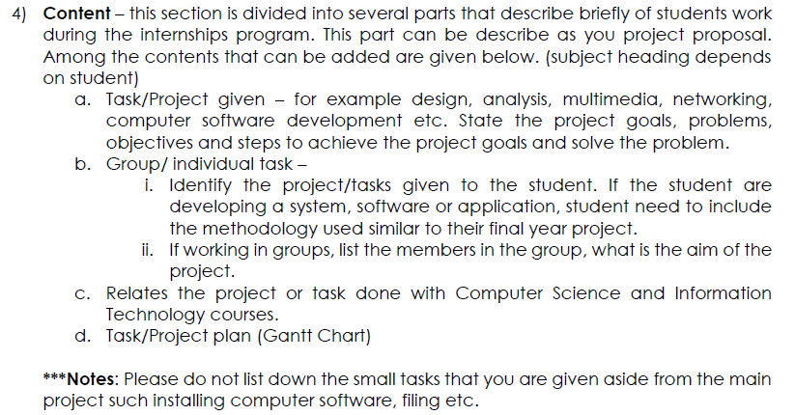
Preliminary Industrial Report/Proposal
Please refer to Guide to Preliminary Industrial Training Report version 3 (English & Malay).
Minimum 6 pages report

Slide 11
Second Supervising Phase
Date 26 Dec 2021 – 7 Jan 2022
Arrange a presentation date and time with all supervisors
Student must present their project to both supervisors.
The supervisors will give assessment on the project.
Important:
Student submit Industrial Training Report
Student submit Draft Logbook
Make sure Industrial Supervisor have fill in the Evaluation form and send it back to Faculty Supervisor Completed Assessment Form from Industrial Supervisor.
FACULTY SUPERVISOR’S EVALUATION FORM (UTHM.FSKTM/UA-25/2018)
INDUSTRIAL SUPERVISOR’S EVALUATION FORM (UTHM.FSKTM/UA-24/2018)

Slide 12
Assessment
HL/HG
Passing Mark : 40 / 100
Student mark based on:
Marks from Industrial Supervisor: 50 %
Logbook (10%)
Working performance(15%)
Soft skills - (25%)
Marks from Faculty Supervisor : 50 %
Documentation – logbook, proposal & final report (20%)
Working performance (20%)
Soft skills (10%)
Notes:
12

Slide 13
Final Industrial Training Report
Make sure you refer to the Industrial Training Report Guideline version 3, which is a general guideline for all courses. You can customize your report in chapter 2-Content.
Here you can describe your work in detail, if you are developing a system, mention the methodology you used in the development, just like PSM report.
Minimum 40 pages maximum 50 pages excluding the appendices.
Notes:
Woth rin

Slide 14
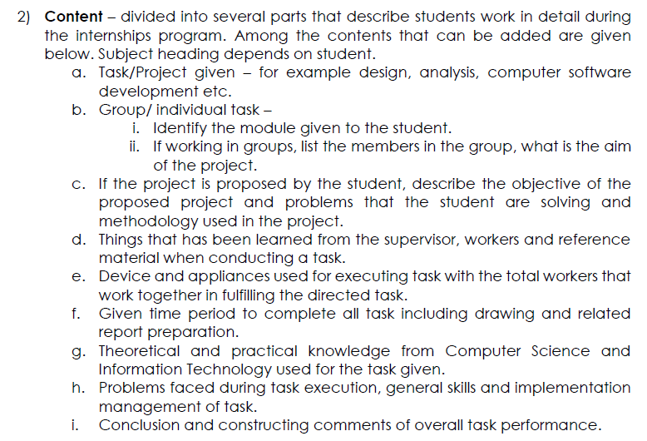

Slide 15
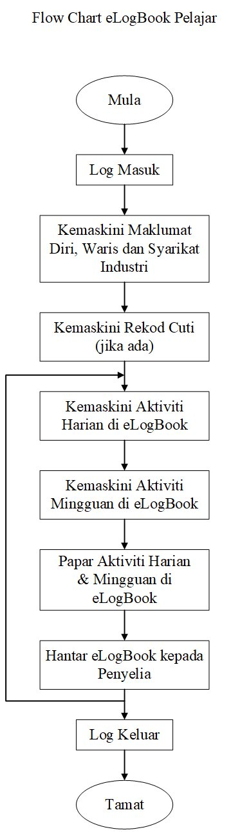
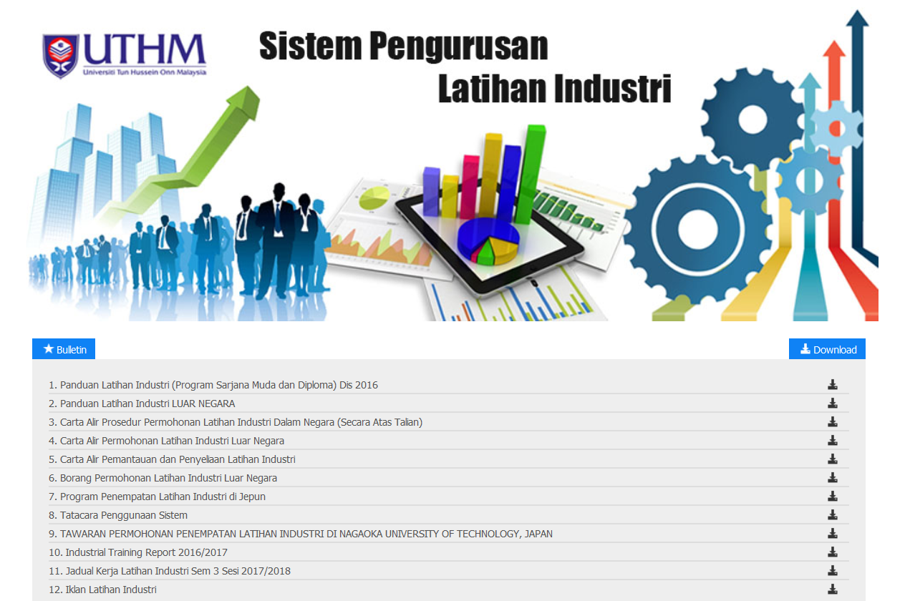
Laporan Harian/ Mingguan atas talian oleh pelajar (eLog Book)

Slide 16
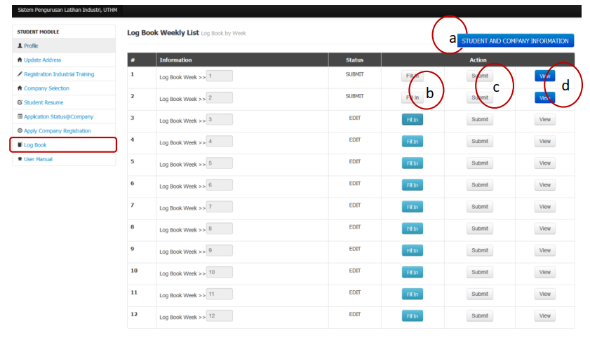

Slide 17
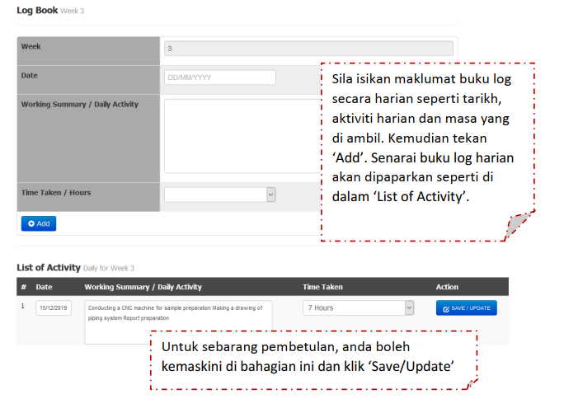

Slide 18
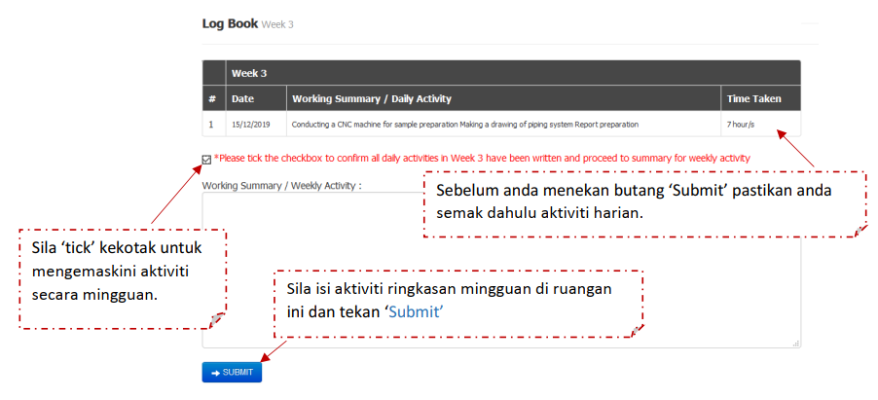

Slide 19
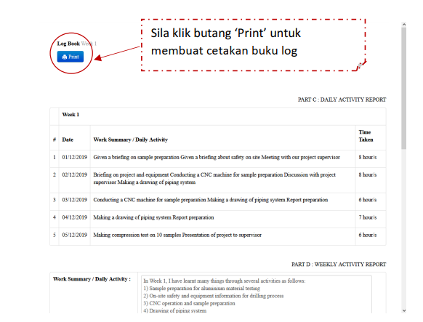
Example of printed version

Slide 20
E-Log Book
Record your activities in e-logbook:
Weekly Activity Report
Daily Activity Report –e-Logbook must be updated daily. Write it in detail.
Download the e-logbook weekly and get signature and stamp from your Industry Supervisor.
Compile the e-logbook together with e-logbook cover (download from eLI), Industrial Training Finished Confirmation Form /borang pengesahan tamat LI (download from Author) – ask for industry supervisor signature and stamp, Faculty Supervisor Evaluation Confirmation Form (Faculty Supervisor will upload in Author), WFH letter and Medical Certificate (MC)
Notes:
20

Slide 21
Discipline, Attendance and Leave
Student must follow all the rules govern by the company. Student must maintain good discipline by practicing good work ethics such as in dressing and communication.
Leave application depend on the company procedures. Any problem should be discussed with your faculty supervisor /coordinator.
Fail to follow rules and maintain disciplines can cause the student to fail and receive HG grade.
Notes:
21

Slide 22
Medical Leave
Submit Medical Leave Certificate (MC)
Attach it to your logbook.
Inform supervisor
Fill in the student leave space and endorse by your supervisor
Students may have to replace the days that they have missed if required by the company.
Notes:
22

Slide 23
Issues
Forging application letter from PHI
Disciplinary action will be taken!
Updating status in social media to show dissatisfaction towards university/staff/department/company
Applying to too many companies and forgot to reject the offers if not interested.
Changing company without permission/reasonable justification .
Notes:
23

Slide 24
Issues
Before changing company, please discuss with the industrial supervisor and coordinator first regarding the issues that you are facing. Write a proper resignation letter and show your professionalism in writing the letter.
Please make sure suggest a project if you are not given any project within the 2nd week of your training.
Make sure your Industrial Supervisor aware of all the procedures about internship.
Any changes of contact number please inform your faculty supervisor.
Notes:
24

Slide 25
Important Tasks
Register LI subject (BIC41812/BIT 40112)
Now the registration for LI subject is automatic taken from ELI system. Please check SMAP after registration week. Please remember if you drop your subject, please contact me then fill in the drop form.
Three reason student name are not registered automatically
Student have debt
Student have not confirmed placement
Student status is inactive.
Have you received any offer letters from companies?
If yes, please confirm your placement with PKKA – li@uthm.edu.my
If not, please check with PKKA. Don’t forget your manners!
Submit Conferment of Degree form to your PA.
Attached copies of SPM result and MUET (>band 3)
Notes:
25

Slide 26
Reminder
Please welcome your supervisor
Make sure Industrial supervisor are there for your presentation
Do not come late for work.
Dress appropriately.
Mingle around with other staff
Be proactive

Slide 27
Current eLI data

Slide 28
Guide to LI
Send cover letter and CV to all potential companies and called them to confirmed they received your CV.
Be proactive, do not wait for offers called them up to ask about their decision. If their respond are negative find other companies.
Find a place before the date of industrial training start.
Student are allowed to receive Work From Home Internship Offer.
If they don’t have an IT department and need your help in developing software or system, please do apply.
If you have two or more offers, ask the companies if they wanted a replacement (among your friend) before rejecting the offers.
Ask your Seniors and lecturers about companies that offers internship placement

Slide 29
FAQ
Can I start earlier than the internship date?
Yes, but the earlier weeks will not be counted in for the 24 weeks. That means you must finish at the same time as your friends. Longer period of internship.
If the company ask to change the starting date, please write a formal letter stated the above.
Can I start later than the internship date?
Student are given maximum 2 weeks extension after the internship date to start internships.

Slide 30
FAQ
Can I reject the first internship offer that I received?
No. It is not advisable to reject the first offer from the company that has been sent to PHI.
If you still want to reject it, please sent a formal written letter stated the reason for the rejection.
Can I change internship placement?
This problem is handled case by case. Normally if the reason is good enough and you have sufficient time to restart your internship elsewhere, the request is permitted. During the first month of your internship duration.
Please send a formal letter to apply for change and stated the reason. If we agree and have contacted the company to verify your reason for change, you must discuss with your company and ask permission for resignation. If they accept your resignation, then you must find a new company as soon as possible

Slide 31
FAQ
What happened if I change the company without permission?
This is VERY SERIOUS OFFENSE. Board of Academic will give you a FAIL.
What happened if I just resign from the company without reporting to the University?
FAIL.

Slide 32
FAQ
Can I apply for a leave of absent?
Your leave of absent depends on your company permission
Student are not advice to apply for leave of absent more then a week. Student must replace the days of absents.
What about leave of absent because of sickness?
Must attached MC to logbook
If more then a week, please submit a written letter reporting the above and mentioned the extension of internship to cover the day of absents. Must have company approval.
Can I apply leave to go for Umrah?
No.

Slide 33


Notes:
33

